Slide 1

NaNoWriMo 2011
Naper
Wri
Mo
The NaNo Writer’s Survival Guide

Slide 2
Session Outline
What is NaNo?
Preparation for writing
Tips for starting out
Enduring the soggy middle
Exercise #2
Tactics to get unstuck
Strategies
NaNo Writing Pitfalls
Notes:
What to expect. This is also flexible.

Slide 3

NaNoWriMo Definitions
What is NaNo?
  “Fast” fiction
  50,000 words in 30 days
  Jumpstarting the process
What is NaNo not?
  Traditional writing exercise
  Torture
  A perfect draft
Notes:
What is NaNo? More importantly, what is it NOT?

Slide 4
Mindset
NaNo’s goal is to write a novel
  50,000 is a horizon to keep your eye on.
Be positive
Keep realistic expectations
  You’re writing a first draft
  Not the next blockbuster… yet
  Not your favourite writer’s next novel
Momentum counts
Notes:
Positive thinking for NaNo:
Novel – a viable manuscript, not words
This is a first draft and not the next blockbuster by Stephen King
Write to exceed your favourite author

Slide 5
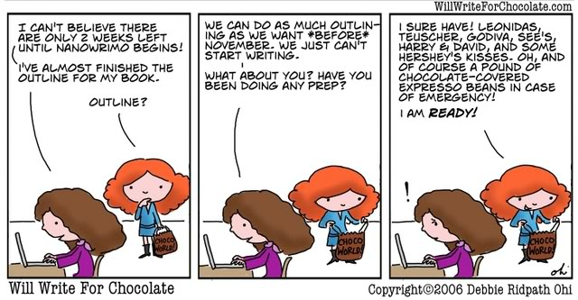
Preparation
Preparation methods to increase success:
  Characterization
  World-Building
  Outlining
  Plotting
  Tools
Notes:
Preparation Intro: Some of these are optional

Slide 6
Preparation
Characterization
  Develop a strong central character
  Keep central to the plot
    Direct stake in events
    Can participate or change things
    Strong motivation
  Create an emotional connection
    Audience cares what happens
  Make sure decisions make sense
  All characters must grow in a story
  Free writing exercises
    Flash fiction for defining events
    Write a letter from char to yourself
Notes:
Characterization
Decisions: Teens going into the spooky house

Slide 7
World Building
  All genres require some degree of world building
    Setting development
    Guides for conflict and character development
  Good: Children of the merchant class are educated.
  Better: Children of the merchant class are educated by the church until they are apprenticed at 12; they join the family business at 16; and enter into arranged marriages by 20.
  Diversity
    Social classes
    Countries
    Cities
    Religions
    Professions
    Races
Notes:
World building
- Structure made at beginning makes it easier to write
Development of setting
Unique qualities about the country
Share in limited touches
Diversity as a source of conflict

Slide 8
Outline
Ingredients for failure:
  No outline
  No central concept
  No record of major events
  Ambiguous premise
  No idea of ending
Even discovery writers (pantsers) need an outline.
Notes:
Why you need an outline.

Slide 9
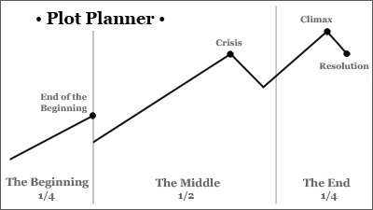
Outline
Keep at least a minimal skeleton
  Main conflict
  Key developments
Notes:
Outlining basics
Post-its: move things around

Slide 10
Outline
Don’t expect to have everything from the start
  Identify major conflicts
  Track subplots
Update as you learn things
  Be flexible
  Post-It notes, note cards
Notes:
Outlining basics
Post-its: move things around

Slide 11
Tips for Starting Out
Know your concept
Write for yourself
Don’t kill yourself
Stay open to possibilities
When it’s hard, you’re getting somewhere
Keep a notebook or device at hand for taking notes – anywhere, anytime
Help is everywhere: Nano forums, Naperville, MLs
Don’t revise
Notes:
When you sit down, you need to prepare yourself with….

Slide 12
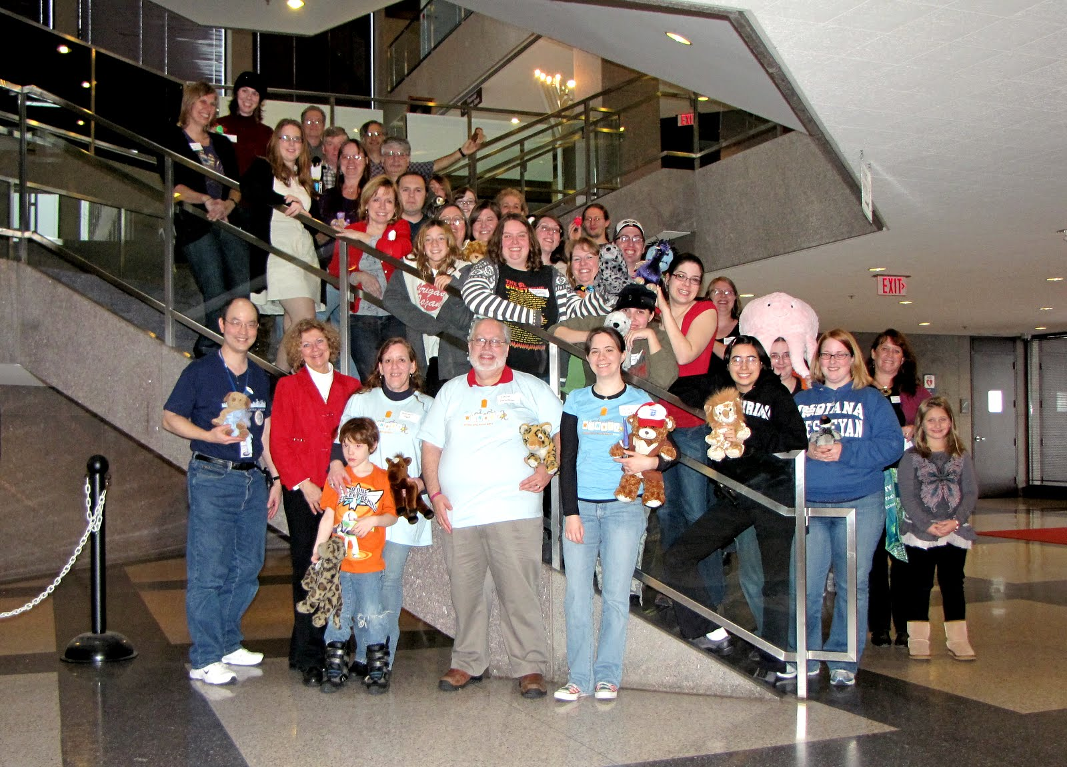
Your Best Resource
Katherine
Writing
NewMexico
Kid
TRRDedean
Notes:
When you sit down, you need to prepare yourself with….

Slide 13
Starting Out
Build a story around an idea you love
  Character, theme, concept, event
  On the right path if the idea won’t get out of your head
Write your NaNo about that
  You’ll be passionate about it
Notes:
Love what you write
You’re stuck with it for a month

Slide 14
Starting Out
Write every single day, no matter how much
  Every little bit counts
  Write anywhere on anything
  Set up a routine
  Attend write-ins, coffee shops
  Avoid distractions at all costs
Save multiple copies of your work
  Save frequently
  Back it up
  Remote accessibility
Notes:
Writing daily = book

Slide 15
Starting Out
Commit to a deadline
  Goal: X words per day
  Update your word count daily
    Benefits Naperville region
    Terrorizes Inspires your writing buddies
  Follow a calendar
  Establish milestones
Notes:
Starting out with a deadline
- Time management pt. 1

Slide 16
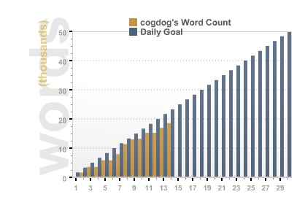
Word Count Graph
Notes:
Someone’s falling behind. WOE.

Slide 17
Starting Out
Don’t stick too closely to your outline
  An outline is a map, not a straitjacket
  Update as you get ideas
Have writing buddies
  Great motivator
  Healthy competition
  Supportive help
Notes:
Outline: room for growth and development

Slide 18
Starting Out
Always be prepared
  Have something to record ideas with
  Write down ideas no matter their quality
  Benefits
    Events for later
    Scene prompts
    Writer’s block busters
    Better solutions
  Don’t trust yourself to remember. You won’t.
Notes:
Carry about notebook stuff

Slide 19
Starting Out
Don’ts
  Stop
  Make major changes in direction
  Delete or rewrite
  Scrap your project/restart
  Abandon story planning
  Cease exploring
  Forget your story’s roots
  Include too many ideas or characters
Notes:
No Nos for starting out

Slide 20
Exercise
  FUN TIME! :D
Notes:
No Nos for starting out

Slide 21
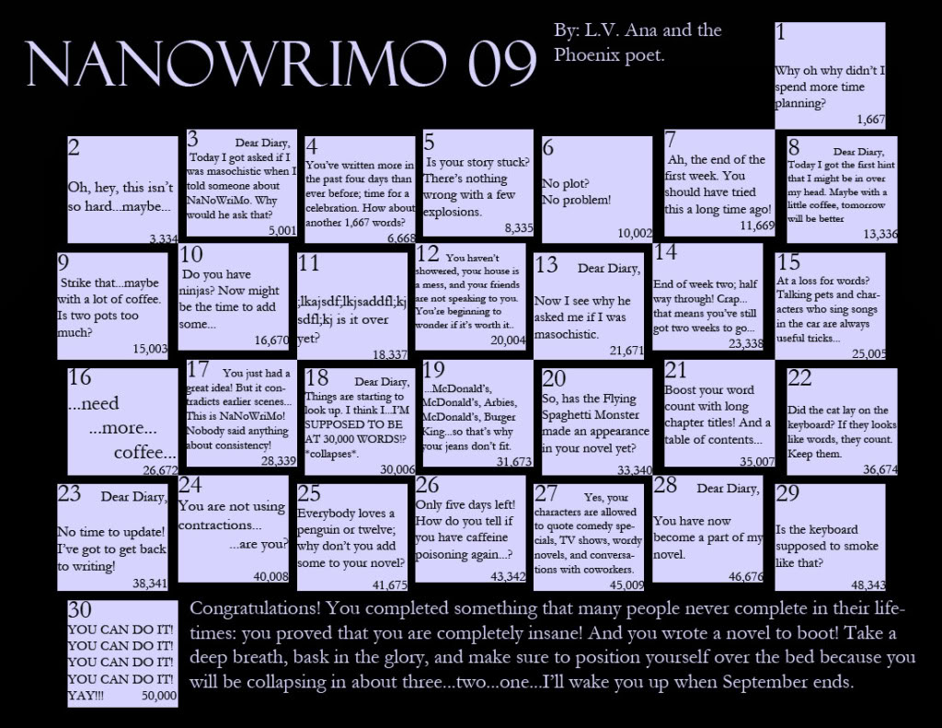
Soggy Middles
  How to maintain your momentum….
Notes:
You’re in the middle of it!

Slide 22
Soggy Middles
Time management is critical
  Dedicate time to writing
  Warn your family and friends
  Remove all distractions
    Research is not writing
    Disconnect from Internet
    Turn off phone
  Set a target
    Duration, word count, pages, chapter
  Track your progress
Notes:
Time management for novel’s success

Slide 23
Soggy Middles
Use conflict to develop story
  Build up dramatic tension
  Put in obstacles
  Grow internal and external conflict
  Change the pace
  Obstruct their progress
When your characters are up a tree, throw rocks at them
Notes:
Conflict is the key ingredient

Slide 24
Soggy Middles
Think ahead to tomorrow when you finish.
  Leave notes for next scene
  Decide your next move
No Nos!
  No deleting work
  Build on previous material
Positive thinking
  Pep talk
  Pat on the back
Notes:
No Nos! Improv technique
Exercise to join/add?

Slide 25
Exercise
FUN TIME! :D
Notes:
Hahaha.

Slide 26
Tactics to Get Unstuck
Write whatever you can:
  Another scene
  Dialogue
  Climax or ending
  Exploratory
    Another idea
    Writing prompts
  Free write
Don’t judge its quality
Notes:
Tactics to get unstuck: WRITE ANYTHING
Don’t wait for the muse to show up

Slide 27
Tactics to Get Unstuck
Spontaneous writing deafens your inner editor
  Word wars
    Jabber chat
    Write-ins
  Timers
  Deadline writing
  Challenge writing buddies
Notes:
Unleashing creativity by different methods
Speed writing
Challenge others

Slide 28
Tactics to Get Unstuck
Spark an idea
    Bring out a flaw
    Fights
    Create a situation
      Explain how you got there after
    Switch drivers
    Focus on another character
    Add complications
      What’s the worst thing that could happen?
Notes:
Spark those ideas
Switch drivers: put char in the scene and let them drive it
Change perspective
Make something unexpected happen
Rocks and tree

Slide 29
Tactics to Get Unstuck
Find inspiration from:
  Parallel genres
  Newspaper headlines
  Films, TV shows, books
  Music
  Popular characters
  Ask what if
Notes:
Exercise to use a favourite character in a totally different situation
→ Jumping off points

Slide 30
Tactics to Get Unstuck
Banana method
Chance method
  Story/plot generators
  Rolling dice
Refer to your notebook of ideas
Notes:
Banana: shake yourself up, move around for 30s-1m. The first word out of your mouth starts sentence

Slide 31
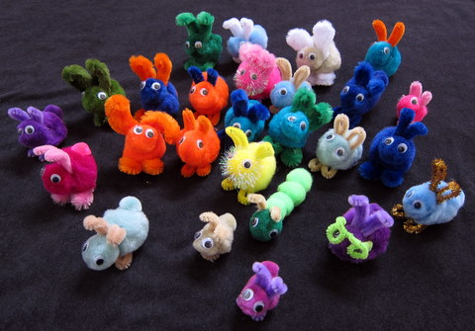
Tactics to Get Unstuck
Reward yourself
Notes:
Plot BUNNIES!

Slide 32
Critical Strategies
Write every day.
  1,667 words/day to reach 50,000
Always keep moving forward
Block out distractions
Be mercenary with your time
Leave yourself placeholders if you get stuck
Shake things up
Use Naperville resources
Always keep moving forward*
Notes:
Ways to keep going towards a goal

Slide 33
NaNo Writing Pitfalls
Lacking direction
Editing as you go
Forgetfulness
Writing yourself into a corner
Negative thoughts
Stopping at a road block
Sweating the small stuff
Isolation
Notes:
Things to avoid
Forgetting what you were doing
Flying by seat of your pants
No direction
Stopping when you shouldn’t
DOUBT
Not reaching out/participating

Slide 34
References
Naper
Wri
Mo
Story Engineering
Writing Excuses
Writer’s Digest
Writer Unboxed
Plot Whisperer

Slide 35

Software
Naper
Wri
Mo
Notes:
Software links if you need them. Taken from Nano site.

Slide 36
Closing
Thank you to Tom for his outline.
Any questions?
Notes:
Plotting exercise.

Slide 37
Last Words
Naper
Wri
Mo
Just write.
Notes:
Last slide.

