Slide 1

NaNoWriMo 2011
Naper
Wri
Mo
The NaNo Writer’s Survival Guide

Slide 2
Session Outline
What is NaNo?
Preparation for writing
Tips for starting out
Exercise #1
Enduring the soggy middle
Exercise #2
Tactics to get unstuck
Strategies
NaNo Writing Pitfalls
Notes:
What to expect. This is also flexible.

Slide 3

NaNoWriMo Definitions
What is NaNo?
What is NaNo not?
Mindset
The goal is to write a novel.
Notes:
What is NaNo? More importantly, what is it NOT?
“Fast” fiction
50,000 words in 30 days
Jumpstarting the process
Traditional writing exercise
Torture
A perfect draft

Slide 4
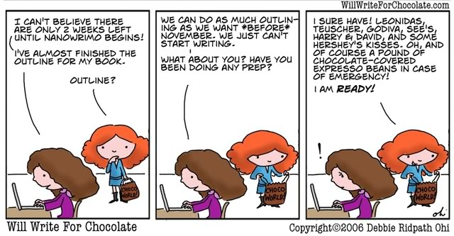
Preparation
Preparation methods to increase success:
  Characterization
  World-Building
  Outlining
  Plotting
  Tools
Notes:
Preparation Intro: Some of these are optional

Slide 5
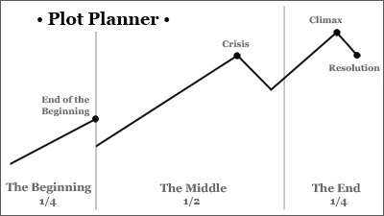
Outline
Keep at least a minimal skeleton
  Main conflict
  Key developments
Notes:
Outlining basics
Post-its: move things around

Slide 6
Tips for Starting Out
Know your concept
Write for yourself
Don’t kill yourself
Stay open to possibilities
When it’s hard, you’re getting somewhere
Keep a notebook or device at hand for taking notes – anywhere, anytime
Help is everywhere: Nano forums, Naperville, MLs
Don’t revise
Notes:
When you sit down, you need to prepare yourself with….

Slide 7
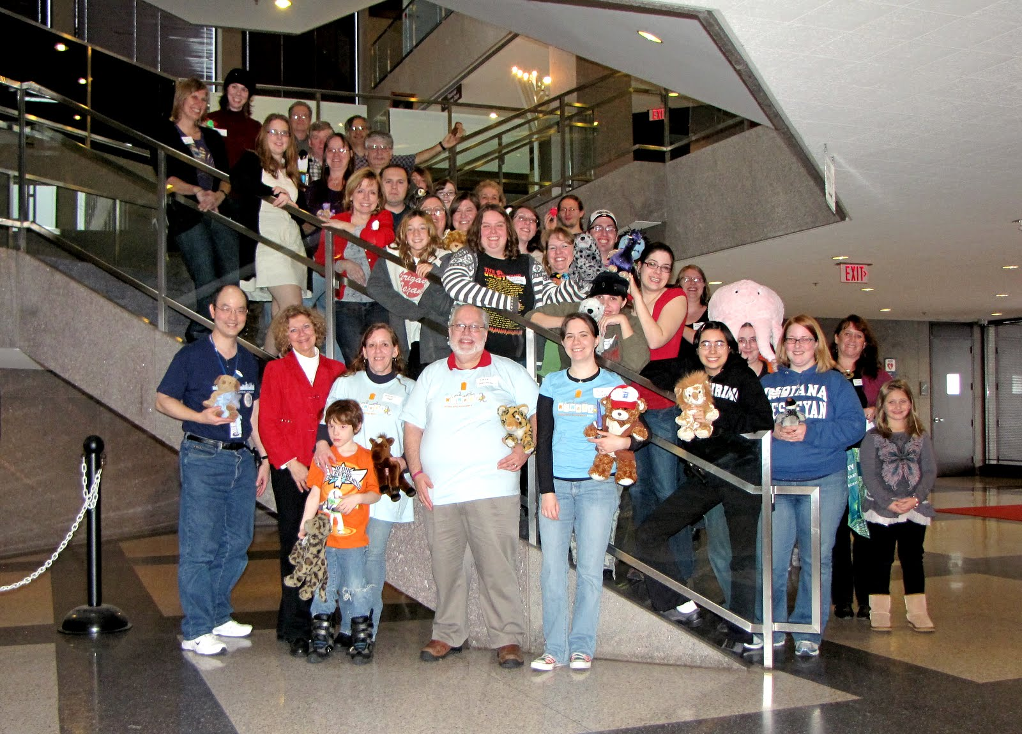
Your Best Resource
Katherine
Writing
NewMexico
Kid
TRRDedean
Notes:
When you sit down, you need to prepare yourself with….

Slide 8

Starting Out
Write about an idea you love
Always be prepared
Write daily
Notes:
Love what you write
You’re stuck with it for a month

Slide 9
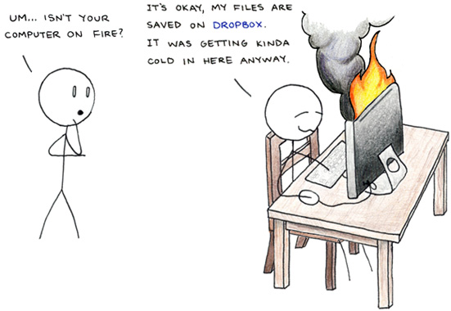
Starting Out
Save multiple copies
Use milestones
Flexible outline
Writing buddies
Notes:
Love what you write
You’re stuck with it for a month

Slide 10
Starting Out
Build a story around an idea you love
  Character, theme, concept, event
  On the right path if the idea won’t get out of your head
Write your NaNo about that
  You’ll be passionate about it
Notes:
Love what you write
You’re stuck with it for a month

Slide 11
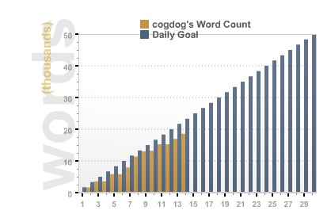
Word Count Graph
Notes:
Someone’s falling behind. WOE.

Slide 12
Starting Out
Don’ts
  Stop
  Change direction
  Rewrite or scrap
  Cease exploring
  Forget your story’s roots
  Do too much at once
Notes:
No Nos for starting out

Slide 13
Exercise
  Write a scene:
  Your character is trying to get into some place without the proper permission.
  Like crashing a movie theater, or a battle-planning session, or a wedding, or a funeral, or...)
Notes:
No Nos for starting out

Slide 14
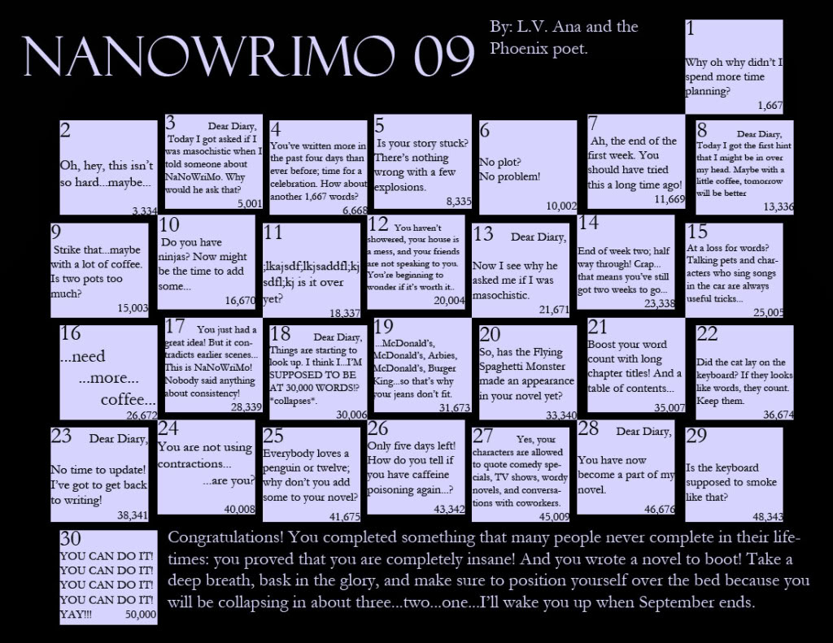
Soggy Middles
  How to maintain your momentum….
Notes:
You’re in the middle of it!

Slide 15
Soggy Middles
Time management
Use conflict
Think ahead
No Nos!
Positive thinking
Notes:
Time management for novel’s success

Slide 16
Exercise
Improv Exercise:
Need two stock characters
Get a location
Have a problem
Write the scenario in your group
Discuss the challenges
Notes:
Hahaha.

Slide 17
Tactics to Get Unstuck
Write whatever you can
Spontaneous writing
Spark ideas
Inspiration
Idea book
Rewards
Notes:
Tactics to get unstuck: WRITE ANYTHING
Don’t wait for the muse to show up

Slide 18
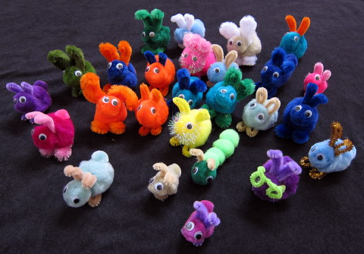
Tactics to Get Unstuck
Reward yourself
Notes:
Plot BUNNIES!

Slide 19
Critical Strategies
Write every day.
  1,667 words/day to reach 50,000
Always keep moving forward
Block out distractions
Be mercenary with your time
Leave yourself placeholders if you get stuck
Shake things up
Use Naperville resources
Always keep moving forward*
Notes:
Ways to keep going towards a goal

Slide 20
NaNo Writing Pitfalls
Lacking direction
Editing as you go
Forgetfulness
Writing yourself into a corner
Negative thoughts
Stopping at a road block
Sweating the small stuff
Isolation
Notes:
Things to avoid
Forgetting what you were doing
Flying by seat of your pants
No direction
Stopping when you shouldn’t
DOUBT
Not reaching out/participating

Slide 21
References
Naper
Wri
Mo
Story Engineering
Writing Excuses
Writer’s Digest
Writer Unboxed
Plot Whisperer

Slide 22

Software
Naper
Wri
Mo
Notes:
Software links if you need them. Taken from Nano site.

Slide 23
Closing
Thank you to Tom for his outline.
Any questions?
Notes:
Plotting exercise.

Slide 24
Last Words
Naper
Wri
Mo
Just write.
Notes:
Last slide.

